Slide 1
T. Anoosha Madhu Kiran
VIII – “C”
S.St Project
JUDICIARY

Slide 2


Introduction
Judiciary plays an important role in any society.
Judiciary is divided into different levels.
Judiciary interprets the law of the land and guides all section of the society in following the law of the land namely the constitution.
In the foregoing slides various aspects of judiciary are discussed.

Slide 3
Simple Introduction
We all know that all laws apply equally to all persons and that a certain set of fixed producers need to be followed when a law is violated.
To enforce this rule of law, we have a judicial system that consists of the mechanism of courts that a citizen can approach when a law is violated.

Slide 4
As an organ of the state, the judiciary plays a crucial role in the functioning of India’s democracy.
It can play this role only because it is independent.
But do you know what does an “independent judiciary” mean ? We will learn about it but before learning we have a small question: is there any connection between the court in your area and the supreme court in New Delhi ?

Slide 5
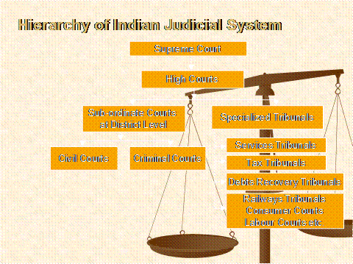
Picture of Hierarchy of Indian Judicial System

Slide 6
Hierarchy of Indian Judicial System
1) Supreme court.
2) High court.
3) Sub- ordinate at district level.
4) Civil court.
5) Criminal court.
6) Specialized tribunals.
7) Services tribunals.
8) Tax tribunals.
9) Debts recovery tribunals.

Slide 7
10) Railways tribunals.
11) Consumer courts.
12) Labour courts.

Slide 8
Role of judiciary
There are five organs :
1) Executive
Legislature
Judiciary
Press and communication
Media.

Slide 9
In these five organs there are three main organs they are :
Executive
Legislature
Judiciary
4) But what is the meaning of executive and legislature ?

Slide 10
Executive means government.
Legislature means parliament.
We learnt what is executive and legislature. But what do you know about the Role of the Judiciary.
Role of the Judiciary means :
Which makes the law.
Which implements the law.

Slide 11
There are two types that is :
Dispute Resolution : The judicial system provides a mechanism for resolving disputes between citizens, between citizens and the government, between two state governments and between the centre and state governments.
Judicial Review : It means that any law passed by a legislature or by a executive is reviewed by judiciary.

Slide 12

Picture

Slide 13
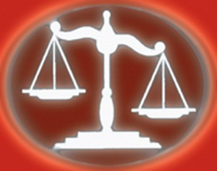
Picture

Slide 14
Independent Judiciary
Do you know what is an independent judiciary ?
Independent means : self governing or maverick.
Judiciary means : legal judicial or cursory.

Slide 15

The lack of independence would force the judge to make all judgments in favour of the politician.
One aspect of this independence is the “separation of powers”.
It means that other branches of the state-like the legislature and the executive cannot interfere in the work of the judiciary.
The courts are not under the government and do not act on their behalf.

Slide 16

Working of the Separation of Powers
Separation of power is important that all judges in the High Court as well as the Supreme Court are appointed with very little interference from the state.
Once appointed, it is very difficult to remove a judge.
It also plays an important role in protecting the Fundamental Rights.

Slide 17
It is also crucial that all judges in the High Court as well as the Supreme Court are appointed with very little interference from these other branches of the government.
Once appointed to this office, it is also very difficult to remove a judge.
It also plays a crucial role in protecting the fundamental rights of citizen because anyone can approach the courts if they believe that their rights have been violated.

Slide 18
Structure of courts in India
So, now we know that what is independent judiciary.
But have you ever studied the Structure of courts in India ?
There are three different levels of courts in our country. There are several courts at the lower while there is only one at apex level.

Slide 19
The courts that most people interact with are called subordinate or district courts.
Each state is divided into district which are presided over by a district judge.
Each state has a high court which is the highest court of that state.
The top is the supreme court that is located in New Delhi and it is presided over by the Chief Justice of India.

Slide 20
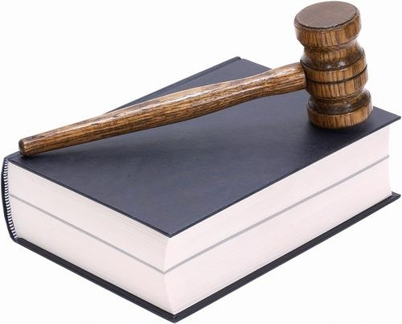
Picture

Slide 21

High courts were first established in the three presidency cities of Calcutta, Bombay and Madras in 1862.
High court of Delhi came up in 1996.
There are 21 high courts.
While many states have their own high courts, Punjab and Haryana share a high court at Chandigarh.

Slide 22
So, now we know the structure of courts in India. Before going to the different branches of the Legal System. We have a question.
Are these different levels of courts connected to each other? If yes, why?
To understand this integration is through the appellate system that exists in India.

Slide 23
Supreme court
Supreme court is also known as Apex court.
Supreme court has 26 members. Lawyers or members will sit in the constutional bench when the case is important.
Lawyers when they sit on the constutional bench the number should be in odd not in even.
So, we all know what is supreme court. We have to study the different branches of the legal system. But do you know what is legal system?

Slide 24
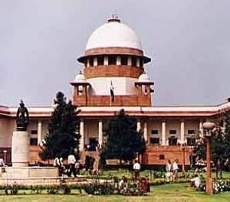
Supreme Court

Slide 25
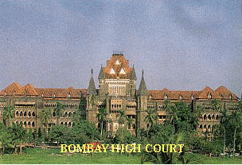
Bombay High Court

Slide 26
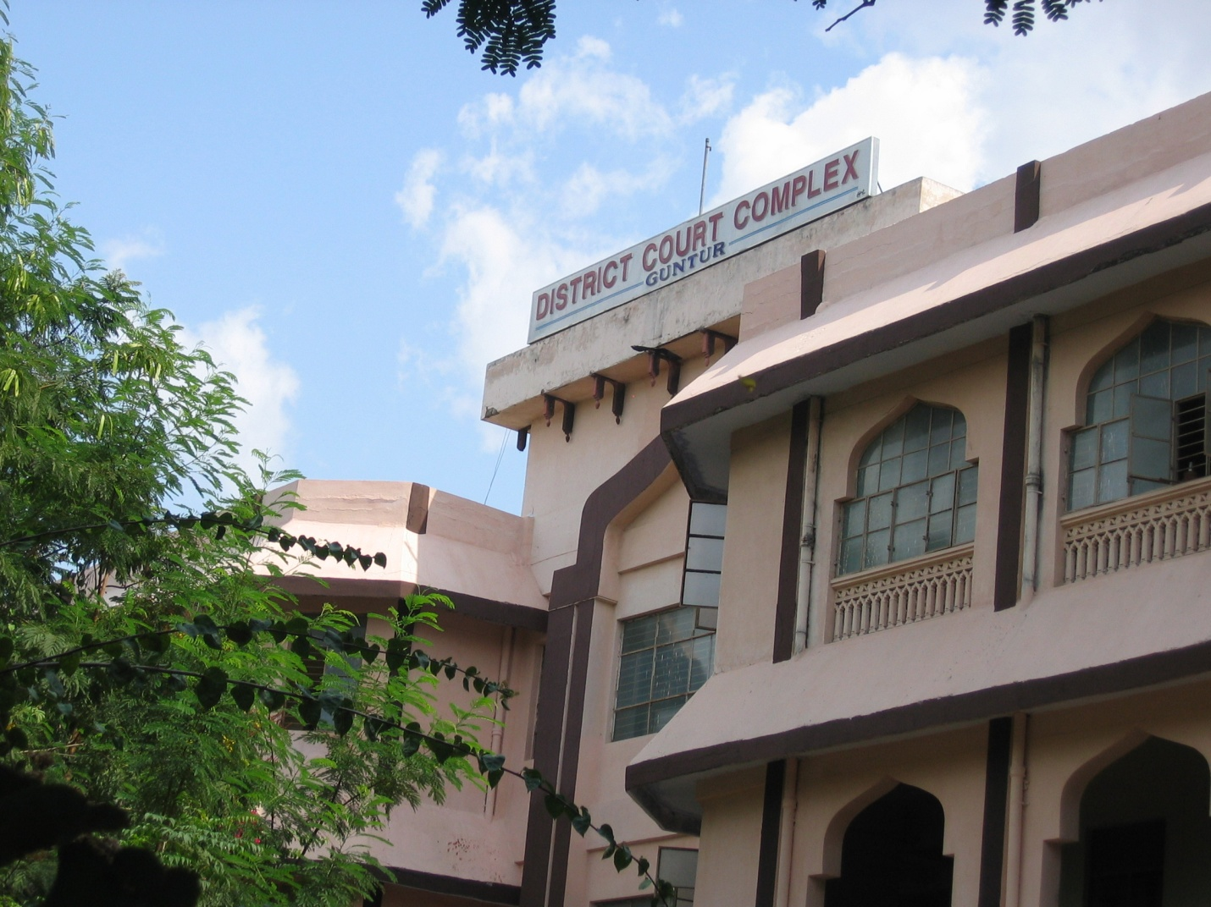
District Court Complex Guntur

Slide 27
Legal system
Legal means lawful, rightful, legalistic, juridical, juristic, judiciary, legislative, statutory and de jure.
Legal system is a violation of criminal law.
In addition to criminal law, the legal system also deals with civil law cases.
We will look at the following table to understand some significant differences between criminal law and civil law.

Slide 28
Criminal law
Deals with conduct or acts that the law defines as offences.
Example : theft, harassing a woman to bring more dowry and murder.
It usually begins with the lodging of an First Information Report (FIR) with the police who investigate the crime after which a case is filed in the court.

Slide 29
If found guilty, the accused can be sent to jail and also fined.
After a person is arrested it is the court of law that decides whether the accused person is guilty or not.
Do you know who introduced criminal system and in which year?
British Govern- General William Bentik has introduced criminal system in the year 1772.

Slide 30

Picture

Slide 31

Civil law
Deals with any harm or injury to rights of individuals.
Examples : Disputes relating to sale of land, purchase of goods, rent matters and divorce cases.
A petition has to be filed before the relevant court by the affected party only. In a rent matter, either the landlord or tenant can file a case.

Slide 32
The court gives the specific relief asked for.
So, we now know what is criminal law and civil law. We have a question that is what do you call a civil court in Muslim language?
Sadar-e- diwani adalt.

Slide 33

Access to the courts
It is a principal in India can access to the courts. If any citizen believes that their rights are being violated then they can approach to the court for the justice to be done.
The supreme court in the early 1980s devised a mechanism of Public Interest Litigation or PIL to increase access to justice. In early years PIL was used to secure justice on a large number of issues such as rescuing bonded labourers from inhuman work conditions.

Slide 34
Do you know who introduced PIL?
PIL was introduced by American people.
The courts interpreted Article 21 of the Constitution on the Right to Life to include the Right to Food.
For the common person access to courts is access to justice.

Slide 35
Human Rights
Do you know what is human rights.
Human rights means the rights to the life, liberty, equality and dignity of the individual guaranteed by the Constitution or embodied .
In the International covenants and enforceable by Courts in India.

Slide 36

Articles
Article 1 : All human beings are born free and equal in dignity and rights.
Article 2 : Everyone is entitled to all the rights and freedom set forth in this declaration without distinction of any kind such as : race, colour, sex, language and religion and political.

Slide 37
Article 3 : Everyone has the right of life, liberty and security of person.
Article 4 : No one shall be held in slavery or servitude, slavery and the slave trade shall be prohibited in their forms.
Article 5 : No one shall be subjected to torture or to cruel, inhuman or degrading treatment or punishment.

Slide 38
Article 6 : Everyone has the right to recognition everywhere as a person before the law.
Article 7 : All are equal before the law and are entitled without any discrimination to equal protection of law.
Article 8 : Everyone has the right to an effective remedy by the competent

Slide 39
National tribunals for act violating the fundamental rights granted to him by the constitution or by law.
Article 9 : No one shall be subjected too arbitrary arrest, detention or exile.
Article 10 : Everyone is entitled in full equality to a fair and public hearing by an independent and impartial tribunal.

Slide 40

The Indian Constution also envisages a secular state.
It , therefore guarantees freedoms of religion in Articles 25 to 28 to all persons, whether they belong to minority community or majority community.
The freedom guaranteed in these includes the following.

Slide 41
Article 25 : Freedom of conscience and free profession, practice and propagation of religion.
Article 26 : Freedom to manage religious affairs.
Article 27 : Freedom from taxation for promotion of any particular religion.
Article 28 : Freedom from compulsory religious worship or attendance at religious instructions in educational institutions.

Slide 42
Justice delayed is justice denied
This phrase “justice delayed is justice denied” is often used to characterise this extended time period that courts take.
There is no denying that the judiciary has played a crucial role in democratic India, serving as a check on the powers of the executive and the legislature as well as in protecting the Fundamental Rights of citizens.

Slide 43
The members of the Constituent Assembly had quite correctly envisioned a system of courts with an independent judiciary as a key feature of our democracy.
In a speech made on 26th November 2007, the Chief Justice of India K.G. Balakrishnan noted that, “The India judiciary consists of one Supreme court with 26 judges, 21 high court with a sanctioned strength of 725 judges.

Slide 44
Story of justice delayed is justice denied
Mohan was the only bread owner in his family.
He was killed in an accident leaving behind his widow and two daughters in 1980.
His widow filed a case for compensation and a job on compassionate ground.
The court lingered on the case for more than 28 years.

Slide 45
She worked on the fields and her daughters worked as maid or domestic helpers.
With her hard work she was able to earn her livelihood .
She borrowed money from the landlord and got her daughters married to poor grooms.

Slide 46

The case was decided and a compensation of Rs 5 lakh was awarded to her.
Now this money does not have any value for the widow.
Justice has been delayed for 28 years.
Hence, it is rightly said that justice delayed is justice denied.

Slide 47
Appellate system
Appellate system is the judicial system through which an appeal is made in the higher court against the judgment of the lower court.
In the appellate system the judgment of the lower court can be reviewed, up held in struck down by the higher court.
Example : a case about State(Delhi administration) Vs. Laxman Kumar and others (1985) from the lower court to the supreme court.

Slide 48
Conclusion
The above slide show clearly indicates the significant role played by the judiciary.
It not only decides the civil and criminal cases but also plays an adjudicatory role in guiding the executive and legislature.
At times judiciary lays down the legal rules according to the necessity of the society, if no legislation is made by the executive to guide the executive and people in discharging their obligations constitutionally.

