Slide 1
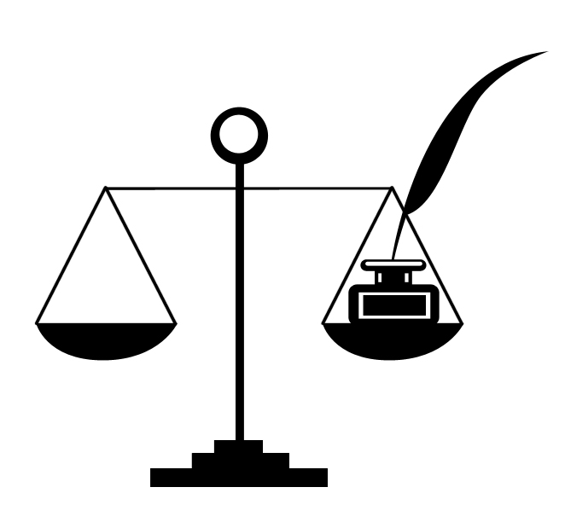
DATA ANALYSIS AND TOOLS IN LEGAL RESEARCH
Dr TSN Sastry
Prof & Head
Department of Law
University of Pune

Slide 2
Introduction
Research play a vital role in every field especially in a normative science like Law.
Research design mostly involves the process of moving from concept to result orientation.
To undertake a comprehensive study the most important to this is Data collection and Analysis. In Data collection and Analysis a number of approaches are required in order to enable a researcher to find out high quality inferences.
In this apart from various tools and approaches of interdisciplinary, Statistics play a vital role which mostly not realised by legal scholars

Slide 3
Relation between Law and Statistics
What is statistics?
According to Wallis and Roberts- Statistics is a body of methods for making wise decisions in the face of uncertainty.
Horace Secrist: “ By Statistics we mean aggregates of facts affected to a marked extend by multiplicity of causes numerically expressed, enumerated or estimated according to reasonable standards of accuracy, collected in a systematic manner for a pre-determined purpose and placed in relation to each other.”

Slide 4
Features of Data Analysis
There should be aggregates of facts
They should be affected to a marked extent by multiplicity of causes
They should be numerically Expressed
They should be estimated according to reasonable accuracy
Data should be systematic collection
Data Need to be Collected for a Pre Determined Purpose
Statistics should be placed in relation to each other Science

Slide 5
Statistical instruments in Legal Research:
Identification of Variables
Back Ground Variables
Chronological Factors
Substantive Provisions
Outcome Variables
Qualitative Analysis

Slide 6
The general Methods to Analyse data
Qualitative Analysis- It mainly aims at the usefulness of the data and the interactions/interviews that a researcher has had with the participants of the project.
Interviews Case Studies and Observatory Methods: It Includes extensive methodic aspects like interviews with public, case studies that affect a section of people, observation of methods by participatory means, analaysing the data of cases and legislation and all these are necessary.
Content Analysis: It includes analysis of the books, articles, journals, case studies, legal briefs, case studies undertaken, periodical analysis and other aspects.

Slide 7
Continued…
Quantitative Analysis:
It is a factor which helps a research to collect the data and analyse the varied results. For any aspect of legal research this is helpful.
Data Presentation and Analysis:
The collected data need to be analysed and presented in a systematic manner and perspective.
Writing up the thesis or Paper:
After analysis, and study the writing of paper has
different stages. It needs a proper presentation
style.

Slide 8
Conclusion
The above brief view brings in that collecting codification analysis of a data play a vital role in legal research.
Apart from all interfaces statistical interface is significant in order to eliminate the quantification of uncertainties.
Theoritisation of research play a vital role however theoritisation alone cannot bring in result oriented inferences without being examined through statistical preferences. To eliminate mismatch and to bring in conjunction between various sciences and normative social science, especially in view of developments in science and technology Data Analysis through statistical method could provide viable results in analysing the behavioural patterns of normative social science.
The expansion of normative social science in the contemporary era needs to be probed thoroughly before authoring the research report for which data analysis and the tools of data are of vital significance

